Slide 1
Linux Kernel - Socket
k100/YILI

Slide 2
Socket from user space to kernel space
In user space
when we want to create the socket
int sock = socket(AF_INET, SOCK_DGRAM,0);
when we want to receive from socket
int len = recvfrom(sock, buf_addr, buf_length, src_ip);
when we want to send data to socket
int len = sendto(sock, buf_addr, buf_length, dest_ip);
Socket(), recvfrom(), sendto() are system call!

Slide 3
System call
System call is the interface between user space and kernel
In Linux kernel, system call can be referred
http://lxr.free-electrons.com/source/net/socket.c#L1219
Take socket() as example
SYSCALL_DEFINE3(socket, int, family, int, type, int, protocol)
Number 3 is standing for parameter number
First parameter is the system call function name.

Slide 4
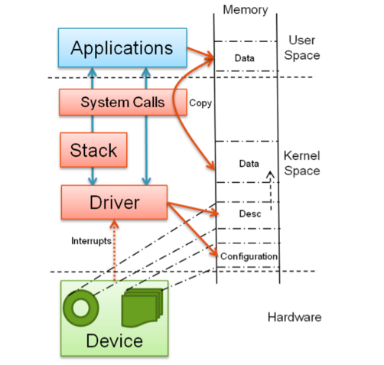
User Space v.s Kernel Space
Notes:
http://www.embedded.com/design/operating-systems/4401769/Device-drivers-in-user-space

Slide 5
Create socket

Slide 6
Create Socket
http://lxr.free-electrons.com/source/net/socket.c#L1219
Create the socket
retval = sock_create(family, type, protocol, &sock);
Map kernel sock to fd and return to user
retval = sock_map_fd(sock, flags & (O_CLOEXEC | O_NONBLOCK));

Slide 7
Function:sock_create
sock_create() -> __sock_create()
http://lxr.free-electrons.com/source/net/socket.c#L1094
Check whether parameter range is valid
if (family < 0 || family >= NPROTO) return -EAFNOSUPPORT;
if (type < 0 || type >= SOCK_MAX) return -EINVAL;
Allocate socket object in kernel space
http://lxr.free-electrons.com/source/net/socket.c#L535
sock_alloc()
struct inode *inode;
struct socket *sock;
inode = new_inode_pseudo(sock_mnt->mnt_sb);
if (!inode) return NULL;
sock = SOCKET_I(inode);
Return sock;

Slide 8
Cont.
sock_create() -> __scok_create()
const struct net_proto_family pf = rcu_dereference(net_families[family]);
Family is AF_NET which is the argument from user
static const struct net_proto_family inet_family_ops = {
.family = PF_INET,
.create = inet_create,
.owner = THIS_MODULE,
};
pf->create(net, sock, protocol, kern)
Inet_create()
struct inet_protosw *answer;
list_for_each_entry_rcu(answer, &inetsw[sock->type], list) {
protocol = answer->protocol;
break;}
}
sock->ops = answer->ops; // define tcp/udp socket behavior

Slide 9
inetsw_array []
http://lxr.free-electrons.com/source/net/ipv4/af_inet.c#L995
/* Upon startup we insert all the elements in inetsw_array[] into * the linked list inetsw*/
static struct inet_protosw inetsw_array[] = {
{
.type = SOCK_STREAM,
.protocol = IPPROTO_TCP,
.prot = &tcp_prot,
.ops = &inet_stream_ops,
.flags = INET_PROTOSW_PERMANENT | INET_PROTOSW_ICSK,
},
{
.type = SOCK_DGRAM,
.protocol = IPPROTO_UDP,
.prot = &udp_prot,
.ops = &inet_dgram_ops,
.flags = INET_PROTOSW_PERMANENT,
},
….
};

Slide 10
inet_dgram_ops
http://lxr.free-electrons.com/source/net/ipv4/af_inet.c#L929
const struct proto_ops inet_dgram_ops = {
.family = PF_INET,
.owner = THIS_MODULE,
.release = inet_release,
.bind = inet_bind,
.connect = inet_dgram_connect,
.socketpair = sock_no_socketpair,
.accept = sock_no_accept,
.getname = inet_getname,
.poll = udp_poll,
.ioctl = inet_ioctl,
.sendmsg = inet_sendmsg,
.recvmsg = inet_recvmsg
…..
};

Slide 11
udp_prot
http://lxr.free-electrons.com/source/net/ipv4/udp.c#L2269
struct proto udp_prot = {
.name = "UDP",
.owner = THIS_MODULE,
.close = udp_lib_close,
.connect = ip4_datagram_connect,
.disconnect = udp_disconnect,
.ioctl = udp_ioctl,
.destroy = udp_destroy_sock,
.setsockopt = udp_setsockopt,
.getsockopt = udp_getsockopt,
.sendmsg = udp_sendmsg,
.recvmsg = udp_recvmsg,
…
};

Slide 12
send

Slide 13
sendto
System call
http://lxr.free-electrons.com/source/net/socket.c#L1625
Copy data in user space to kernel space
import_single_range(WRITE, buff, len, &iov, &msg.msg_iter);
iov->iov_base = buf;
iov->iov_len = len;
msg.msg_iter->iov = iov;
Copy dest address in kernel
move_addr_to_kernel(dest_addr, addr_len, &address);
int move_addr_to_kernel(void __user *uaddr, int ulen, struct sockaddr_storage *kaddr) {
if (copy_from_user(kaddr, uaddr, ulen)) return -EFAULT;
return audit_sockaddr(ulen, kaddr);
}
Call send function
sock_sendmsg(sock, &msg);

Slide 14
Copy_from_user
http://lxr.free-electrons.com/source/arch/m32r/include/asm/uaccess.h#L648
__generic_copy_from_user(void *to, const void __user *from, unsigned long n)
__copy_user_zeroing(to, from, size)
http://lxr.free-electrons.com/source/arch/m32r/include/asm/uaccess.h#L486
Use assembly code to do copy

Slide 15
sock_sendmsg(sock, &msg);
In socket_sendmsg
int err = security_socket_sendmsg(sock, msg, msg_data_left(msg));
return err ?: sock_sendmsg_nosec(sock, msg);
// if err >=1, return err;
else return sock_sendmsg_nosec();
sock_sendmsg_nosec(sock, msg);
http://lxr.free-electrons.com/source/net/socket.c#L608
int ret = sock->ops->sendmsg(sock, msg, msg_data_left(msg));
return ret;
Sock->ops->sendmsg is the function pointer which will point to inet_sendmsg

Slide 16
inetsw_array []
http://lxr.free-electrons.com/source/net/ipv4/af_inet.c#L995
/* Upon startup we insert all the elements in inetsw_array[] into * the linked list inetsw*/
static struct inet_protosw inetsw_array[] = {
{
.type = SOCK_STREAM,
.protocol = IPPROTO_TCP,
.prot = &tcp_prot,
.ops = &inet_stream_ops,
.flags = INET_PROTOSW_PERMANENT | INET_PROTOSW_ICSK,
},
{
.type = SOCK_DGRAM,
.protocol = IPPROTO_UDP,
.prot = &udp_prot,
.ops = &inet_dgram_ops,
.flags = INET_PROTOSW_PERMANENT,
},
….
};

Slide 17
inet_dgram_ops
http://lxr.free-electrons.com/source/net/ipv4/af_inet.c#L929
const struct proto_ops inet_dgram_ops = {
.family = PF_INET,
.owner = THIS_MODULE,
.release = inet_release,
.bind = inet_bind,
.connect = inet_dgram_connect,
.socketpair = sock_no_socketpair,
.accept = sock_no_accept,
.getname = inet_getname,
.poll = udp_poll,
.ioctl = inet_ioctl,
.sendmsg = inet_sendmsg,
.recvmsg = inet_recvmsg
…..
};

Slide 18
inet_sendmsg
http://lxr.free-electrons.com/source/net/ipv4/af_inet.c#L726
struct sock *sk = sock->sk;
sock_rps_record_flow(sk);
return sk->sk_prot->sendmsg(sk, msg, size);
take udp as an exmaple, will call udp_sendmsg();

Slide 19
udp_prot
http://lxr.free-electrons.com/source/net/ipv4/udp.c#L2269
struct proto udp_prot = {
.name = "UDP",
.owner = THIS_MODULE,
.close = udp_lib_close,
.connect = ip4_datagram_connect,
.disconnect = udp_disconnect,
.ioctl = udp_ioctl,
.destroy = udp_destroy_sock,
.setsockopt = udp_setsockopt,
.getsockopt = udp_getsockopt,
.sendmsg = udp_sendmsg,
.recvmsg = udp_recvmsg,
…
};

Slide 20
Udp_sendmsg
In udp_sendmsg it copy data from user space to kernel space
Set routing
struct rtable *rt = NULL; rt = ip_route_output_flow(net, fl4, sk);
Copy from user space to kernel space
ip_append_data(sk, fl4, getfrag, msg, ulen, sizeof(struct udphdr), &ipc, &rt, corkreq ? msg->msg_flags|MSG_MORE : msg->msg_flags);
Getfrag is the function pointer pointing to ip_generic_getfrag /or udplite_getfrag
int (*getfrag)(void *, char *, int, int, int, struct sk_buff *);
int is_udplite = IS_UDPLITE(sk);
getfrag = is_udplite ? udplite_getfrag : ip_generic_getfrag;
Ip_append_data will call __ip_append_data()
if (copy > 0 && getfrag(from, data + transhdrlen, offset, copy, fraggap, skb) < 0){
err = -EFAULT;
kfree_skb(skb);
goto error;
}

Slide 21
Cont.
in ip_generic_getfrag
Copy data from user space to kernel space
if (csum_and_copy_from_iter(to, len, &csum, &msg->msg_iter) != len) {
return -EFAULT;
}
Put packet on the queue
__skb_queue_tail(queue, skb);

Slide 22
recvfrom

Slide 23
Recvfrom()
In user space call recvfrom () (system call)
http://lxr.free-electrons.com/source/net/socket.c#L1681
Find the socket FD
sock = sockfd_lookup_light(fd, &err, &fput_needed);
Call recv function
err = sock_recvmsg(sock, &msg, iov_iter_count(&msg.msg_iter), flags);
Copy sender address from kernel space to user space
move_addr_to_user(&address, 1711 msg.msg_namelen, addr, addr_len);

Slide 24
Cont.
sock_recvmsg ->sock_recvmsg_nosec
int sock_recvmsg_nosec(struct socket *sock, struct msghdr *msg, size_t size, int flags) {
return sock->ops->recvmsg(sock, msg, size, flags);
}
sock->ops->recvmsg is point to inet_recvmsg
inet_recvmsg(struct socket *sock, struct msghdr *msg, size_t size, int flags) {
err = sk->sk_prot->recvmsg(sk, msg, size, flags & MSG_DONTWAIT, flags & ~MSG_DONTWAIT, &addr_len);
}
sk->sk_prot->recvmsg is point to udp_recvmsg

Slide 25
User space get pkt from kernel space
udp_recvmsg
http://lxr.free-electrons.com/source/net/ipv4/udp.c#L1276
Call __skb_recv_datagram()
http://lxr.free-electrons.com/source/net/core/datagram.c#L194
struct sk_buff_head *queue = &sk->sk_receive_queue;
skb_queue_walk(queue, skb)
__skb_unlink(skb, queue);
return skb;
Copy data from kernel space to user space
if (skb_csum_unnecessary(skb)) {
err = skb_copy_datagram_msg(skb, sizeof(struct udphdr), msg, copied);
} else {
err = skb_copy_and_csum_datagram_msg(skb, sizeof(struct udphdr), msg); }
Notes:
udp_queue_rcv_skb(sk, skb) to user space recvfrom()
http://www.360doc.com/content/11/0222/20/61151_95207848.shtmls
*__skb_recv_datagram()
http://blog.chinaunix.net/uid-23629988-id-3013203.html

Slide 26
const
skb_copy_datagram_msg call skb_copy_datagram_iter(from, offset, &msg->msg_iter, size);
http://lxr.free-electrons.com/source/include/linux/skbuff.h#L2790
skb_copy_datagram_iterg call copy_to_iter
http://lxr.free-electrons.com/source/include/linux/skbuff.h#L2790
-in copy_to_iter it will perform copy skb to user space
iterate_and_advance(i, bytes, v,
__copy_to_user(v.iov_base, (from += v.iov_len) - v.iov_len, v.iov_len),
memcpy_to_page(v.bv_page, v.bv_offset, (from += v.bv_len) - v.bv_len, v.bv_len),
memcpy(v.iov_base, (from += v.iov_len) - v.iov_len, v.iov_len)
)
return bytes;

Slide 27
Block I/O v.s. Non-blocked I/O

Slide 28
User Space v.s Kernel Space
Notes:
http://www.embedded.com/design/operating-systems/4401769/Device-drivers-in-user-space

Slide 29
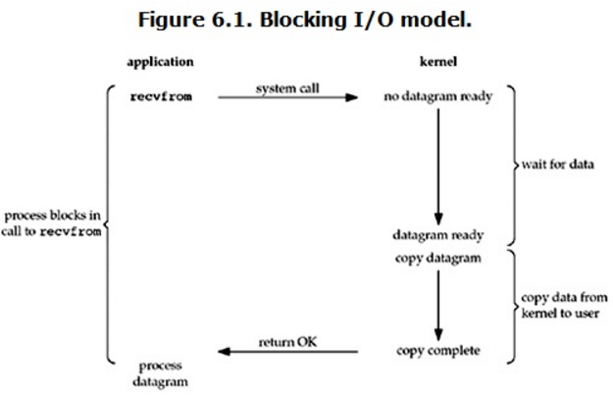
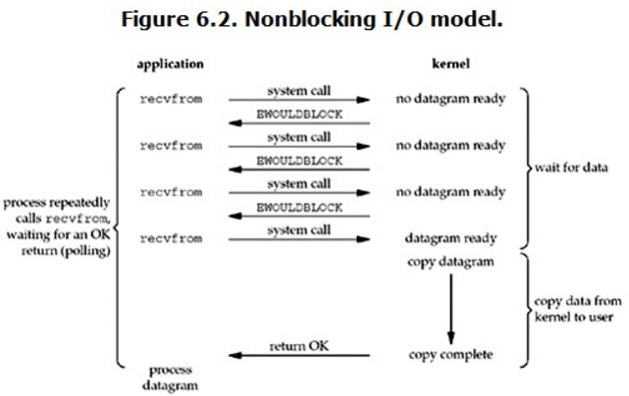
Block I/O vs Non-block I/O
In Linux, it will set up the socket by blocked mode by default.
If we want to set as non-blocked mode,
fcntl(sock, F_SETFL, O_NONBLOCK)

Slide 30
Fcntl System Call in Kernel
System call fcntl(sock, F_SETFL, O_NONBLOCK)
http://lxr.free-electrons.com/source/fs/fcntl.c#L356
err = security_file_fcntl(f.file, cmd, arg);
if (!err)
err = do_fcntl(fd, cmd, arg, f.file);
static long do_fcntl(int fd, unsigned int cmd, unsigned long arg, struct file *filp) {
long err = -EINVAL;
switch (cmd) {
case F_DUPFD:
err = f_dupfd(arg, filp, 0);
break;
case F_DUPFD_CLOEXEC:
err = f_dupfd(arg, filp, O_CLOEXEC);
break;
…
case F_SETFL:
err = setfl(fd, filp, arg);
break;
}
}

Slide 31
Block I/O vs Non-block I/O in Kernel
http://lxr.free-electrons.com/source/net/socket.c#L1681
if (sock->file->f_flags & O_NONBLOCK)
flags |= MSG_DONTWAIT;
http://lxr.free-electrons.com/source/net/core/datagram.c#L209
Set flag is 1 if socket is set up non-blocked mode
timeo = sock_rcvtimeo(sk, flags & MSG_DONTWAIT);
static inline long sock_rcvtimeo(const struct sock *sk, bool noblock) {
return noblock ? 0 : sk->sk_rcvtimeo;
}
Return 0 if sock is set as non-blocked

Slide 32
Cont.
do {
last = (struct sk_buff *)queue;
spin_lock_irqsave(&queue->lock, cpu_flags);
skb_queue_walk(queue, skb) {
last = skb;
*peeked = skb->peeked;
if (flags & MSG_PEEK) {
/*ignore this part*/
} else
__skb_unlink(skb, queue);
spin_unlock_irqrestore(&queue->lock, cpu_flags);
return skb;
}
spin_unlock_irqrestore(&queue->lock, cpu_flags);
if (!timeo)
goto no_packet;
} while (!wait_for_more_packets(sk, err, &timeo, last));
no_packet:
*err = error;
return NULL;
Check if socket receive queue has packet
Return packet if having
goto no_packet under two kind of condition
socket is non-blocked
2. blocked sk but its timeo == 0
Blocked socket will keep here until timeout or get packet

Slide 33
Synchronous I/O v.s. asynchronous I/O

Slide 34
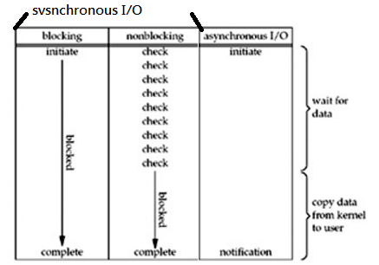
Synchronous I/O v.s. Asynchronous I/O
The definition in POSIX
synchronous I/O operation causes the requesting process to be blocked until that I/O operation completes;
asynchronous I/O operation does not cause the requesting process to be blocked;

Slide 35
Reference
Socket from user space to kernel space(send)
http://blog.chinaunix.net/uid-23629988-id-85907.html
Socket from user space to kernel space(receive)
http://www.cnblogs.com/jinrize/archive/2009/11/29/1612863.html
UDP send
http://www.jiancool.com/article/58102811680/
Detail of UDPsend function
http://blog.csdn.net/minghe_uestc/article/details/7836920
IO models
http://blog.csdn.net/historyasamirror/article/details/5778378
https://scoecomp.files.wordpress.com/2014/02/2003-unix-network-programming-vol-1-3rd-ed.pdf
6.2 I/O Models

